Slide 1
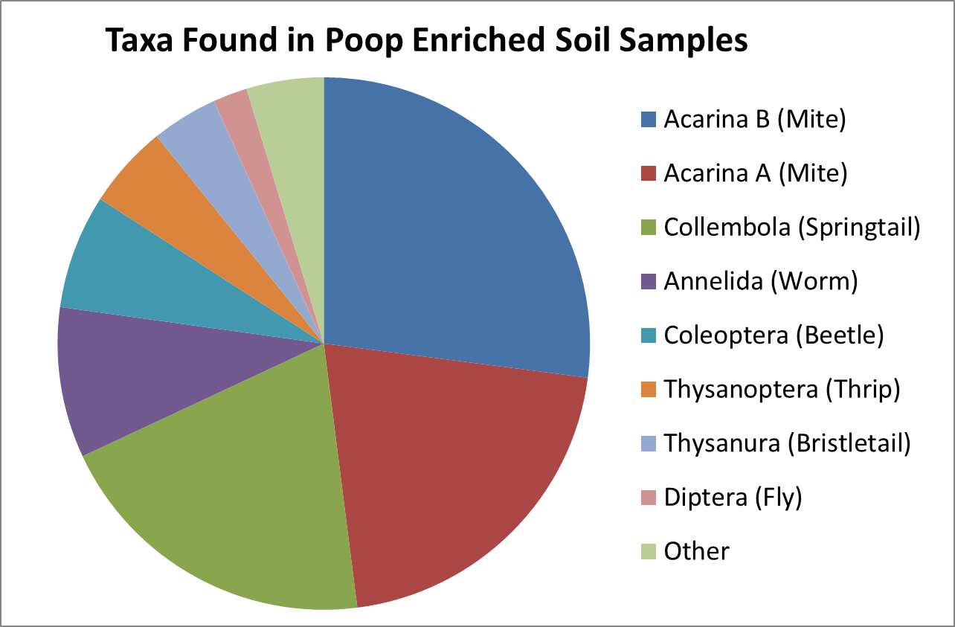
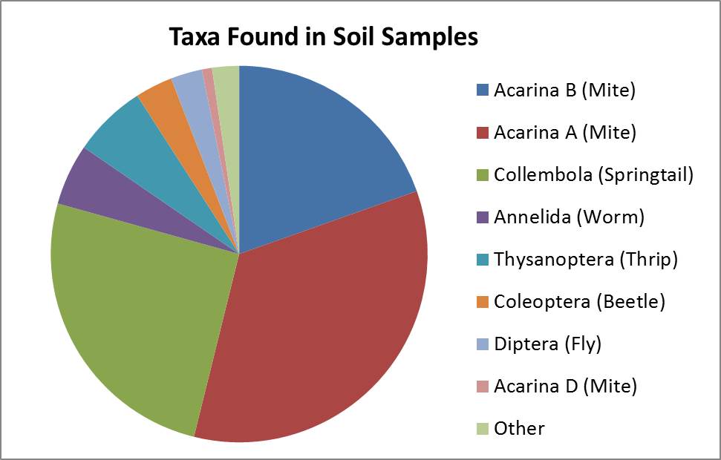
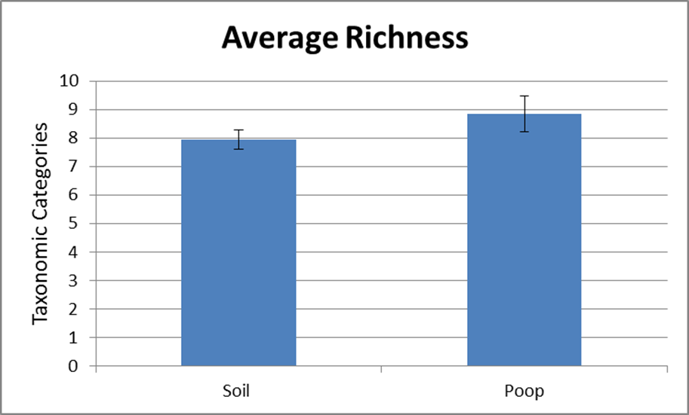
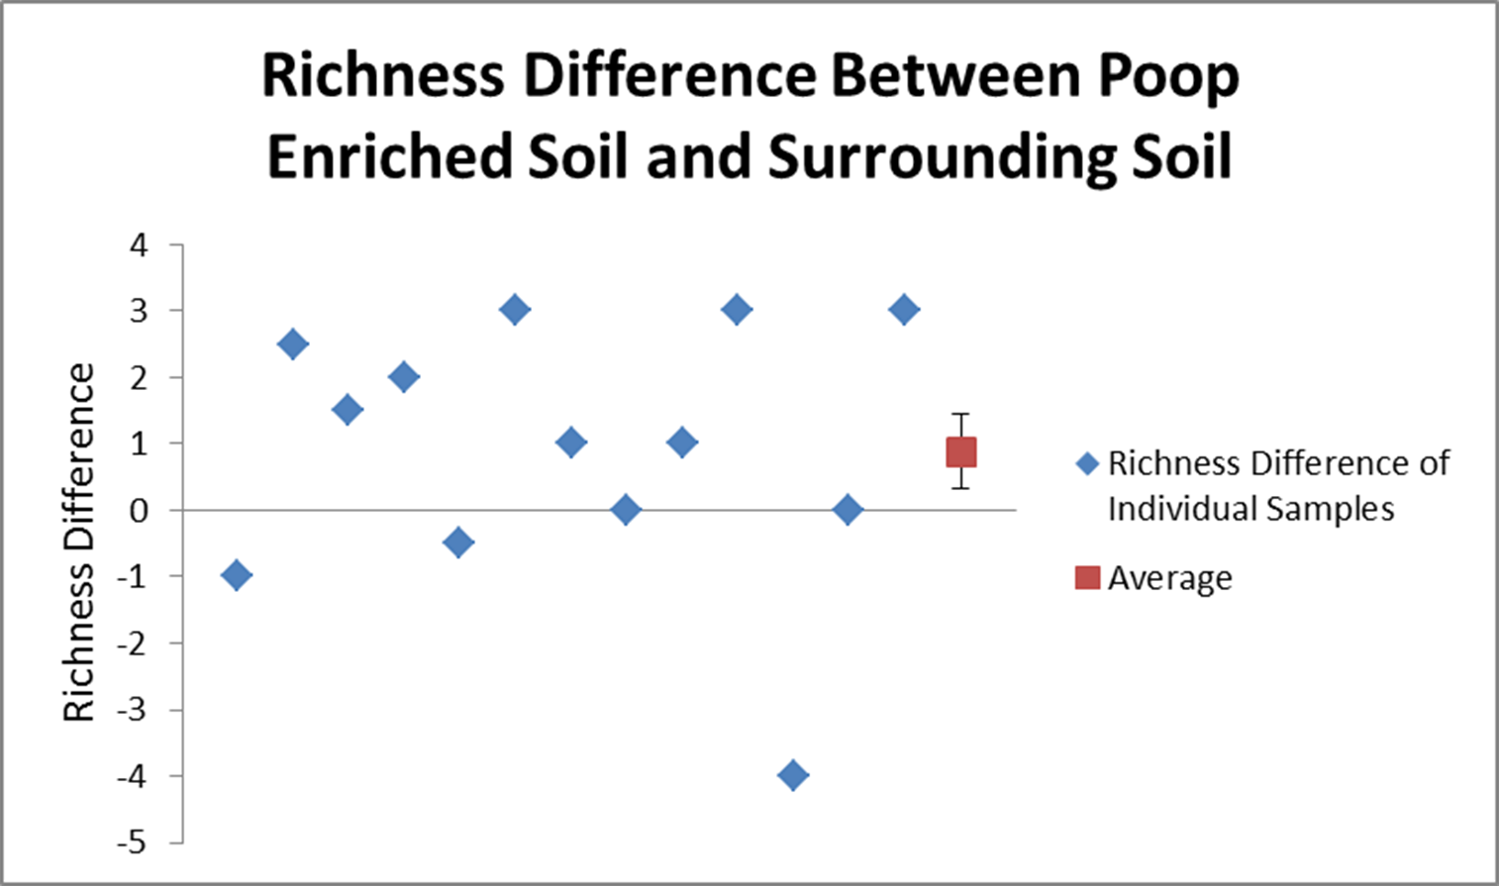
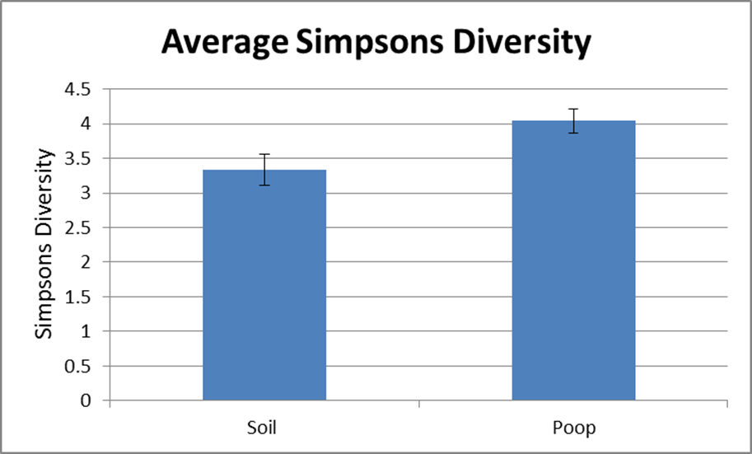
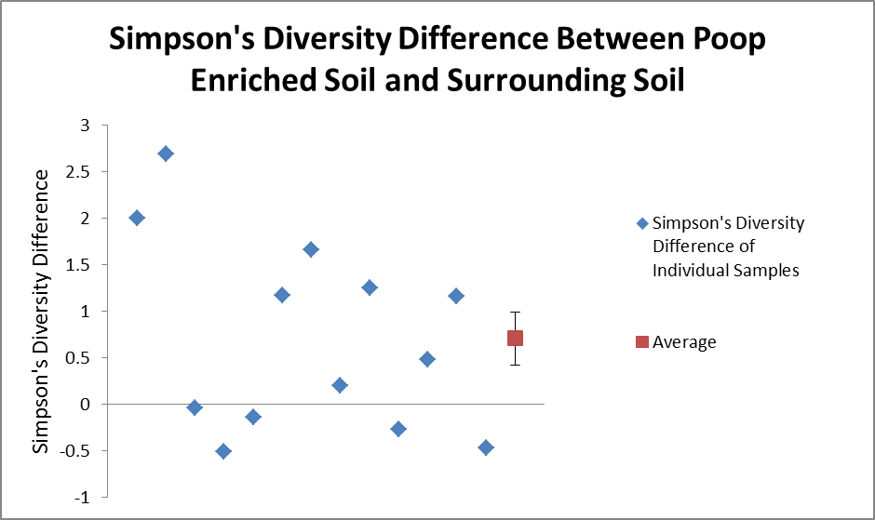
Deer Droppings as a Diverse Invertebrate Habitat
Allie Furr
Augustana College – Green Wing Environmental Laboratory – June 2016
Introduction
Soil invertebrates are a large ‘unseen’ community of animals that indirectly affect our daily lives due to their effect on soil quality. These animals include mites, springtails, worms, flies (adult and larvae), and beetles.
The roles of soil invertebrates are (Boyce 2005):
Consuming dead organic matter
Trapping and releasing CO₂
Ecosystem recovery
Role in the food chain
Soil invertebrates are able to restore and maintain soil quality that has been damaged by agriculture and industrialization (Lavelle et al 2006). The important roles of soil invertebrates have been shown to improve soil quality in Lavelle et al., so next some environmental characteristics that increase the presence of these critters in an ecosystem must be indentified. According to Stork and Eggleton’s 1992 article, organic manure fertilizers increase the abundance of invertebrates in agricultural fields. However this study involved agricultural systems, so this experiment aims to investigate the presence of this trend in a less manipulated ecosystem.
Question: How does the diversity and richness of invertebrates in deer dropping compare to the diversity and richness of invertebrates in the surrounding soil?
Hypothesis: The diversity and richness will be the higher in the poop enriched soil samples.
Results
Conclusions
The data supports one the hypothesis that was being studied, which stated that diversity will be higher in the deer poop enriched soil samples. The data did not support the hypothesis that the richness was higher. As shown in Figure 4, there was one outlier with a richness around -4 and this could be why higher richness for the poop enriched samples was not significant. Soil temperature, pH, and moisture were measured and their data ensured that the13 different sampling locations were not extremely different, so that sampling location could not have been removed from the study.
The deer poop creates a natural fertilizer that maintains a desirable soil invertebrate habitat in a less manipulated ecosystem such as Green Wing Environmental Laboratory. These factors create the following cycle for the healthy ecosystem: feces from animals → good soil quality → plant growth → provide nutrition to herbivores → animals produce feces. In this study, the ecosystem was analyzed through the richness and Simpson’s diversity of invertebrates in the poop enriched and surrounding soil samples. A rich ecosystem is more resilient if destruction occurs because the remaining species can usually perform the functions of the eliminated species (Lavelle et al 2006). Higher Simpson’s diversity in an invertebrate population is important because the soil invertebrates are more equally providing their different roles in their environment. Both higher richness and higher diversity of soil invertebrates indicate better soil quality. Figures 4,5, and 6 showed that the poop enriched soil samples were a better invertebrate habitats. In conclusion, the soil samples that contained deer poop were a more diverse habitat for soil invertebrates than the surrounding soil.
One further study that could be performed is providing a more in depth taxonomic categorization of the invertebrates involved, especially the mites. Another study would be comparing the effect of deer feces on soil invertebrates to the more agricultural example of the effect of cow feces on soil invertebrates.
In this study there were 4,238 individual soil invertebrates that were observed and categorized. Figures 1 and 2 show the top 8 taxonomic categories that were present between the two sample types.
The first method by which the data was analyzed was richness. Richness describes the number of taxonomic categories present. As shown in Fig. 3 the average richness of the poop enriched soil was higher than that of the soil, however the error bars and p values indicate that this difference is not significant. Fig. 4 & 6 are scatter plots representing each sample collected. These graphs were produced by analyzing the difference between poop enriched soil samples and the average of the two soil samples. A dot on the 0 line indicates no difference between the poop and soil, a negative dot means that the soil samples were richer/more diverse, and a positive dot indicates that the poop enriched sample was richer/more diverse. The red point shows the average of all the points. In Figure 4, the average dot is a positive number, indicating that overall the trend is that the poop samples are richer than the surrounding soil, contrary to Figure 3.
Figures 1&2: The pie charts show the dispersion of the top 8 taxa found in the two soil sample types. Many of the taxa are the same, but they are found in slightly different percentages.
Litter decomposition
Soil erosion
Nutrient mineralization
Figure 3: The average richness as a function of the two soil conditions were not significantly different. A T test assuming equal variance with df=37 produced a p value of 0.187. The error bars represent +/- one standard error of the mean.
Figure 4: The difference between the richness values for the different soil samples from each sampling location is shown. The positive values indicate that the poop enriched samples had higher richness values surrounding soil from that sample. The average richness difference was positive with small error bars, that represent one standard error from the mean, SE=0.558.
Figure 5: The average Simpson’s Diversify as a function of the two soil conditions were significantly different. A T Test assuming unequal variance was run with df=36 giving a p value of 0.00885. The error bars represent +/- one standard error of the mean.
Materials and Methods
This experiment was performed at Augustana’s Green Wing Environmental Laboratory in Amboy, IL.
Samples of deer feces were collected on the Green Wing Property and were discovered by following deer paths through wooded areas.
The location of each sample was marked on a GPS.
At the site of the feces, leaf litter and 2 cm deep of soil in a 15 cm square were collected and placed in a sealed bag.
Then soil samples were collected, with the same protocol, 1 meter from the feces sample in two opposite directions.
The samples were placed in Berlese funnels, with approximately 30 mL of 70% ethanol in cups below the funnels. These funnels were allowed to run for 24 hours.
Invertebrates in the ethanol cups were identified and enumerated. The invertebrates were categorized based on general taxonomic descriptions mainly at the order level, using the following reference, www.esa.org/tiee/
vol/v3/experiments/soil/pdf/soil[Invertebrate_Key].pdf.
The second method by which the data was
analyzed was Simpson’s Diversity. Simpson’s
diversity is calculated using the number of
categories and the abundance of each category.
A high Simpson’s diversity means that there are many taxonomic groups and the abundance of each group is fairly equal. The average Simpson’s diversity of the two groups is shown in Fig. 5. This figure shows that on average the poop enriched samples were more diverse than the surrounding soil. Fig. 6 shows the difference between each sample’s poop and surrounding soil samples. As seen by the number of dots in the positive area of the graph, the poop enriched samples were a more diverse invertebrate habitat.
Figure 6: The difference between the richness values for the different soil samples from each sampling location is shown. The positive values indicate that the poop enriched samples had higher richness values surrounding soil from that sample. The average richness difference was positive with small error bars, that represent one standard error from the mean, SE=0.285.
Literature cited
Allombert S, Stockton S, Martin J. 2005. A natural experiment on the impact of overabundant deer on forest invertebrates. Conservation Biology 19(6):1917-29.
Boyce RL. 2005. Life under your feet: measuring soil invertebrate diversity [Internet]. Highland Heights (KY): Ecological Society of America; [cited 4 June 2016]. Available from http://www.esa.org/tiee/vol/v3/experiments/soil/description.html.
Lavelle P, Decaëns T, Aubert M, Barot S, Blouin M, Bureau F, Margerie P, Mora P, Rossi J-. 2006. Soil invertebrates and ecosystem services. European Journal of Soil Biology 42(1):S15.
Stork NE, Eggleton P. 1992. Invertebrates as determinants and indicators of soil quality. American Journal of Alternative Agriculture 7(1,2): 38-47.
Acknowledgments
I would like to thank Augustuana College for use of their Green Wing Environmental Laboratory and Dr. Kevin Geedey for his assistance with the project.
Further information
Contact allisonfurr15@augustana.edu
Notes:
Abstract: This project was preformed at Augustana's Green Wing Environmental Laboratory and studied the richness and diversity of soil invertebrates in two conditions. Soil invertebrates play an important role in soil quality which greatly affects ecosystems. The number of taxa (richness) and the number of individuals in each taxa (Simpson's diversity) were used to compare the two soil conditions of deer poop enriched soil and surrounding soil.

