Slide 1


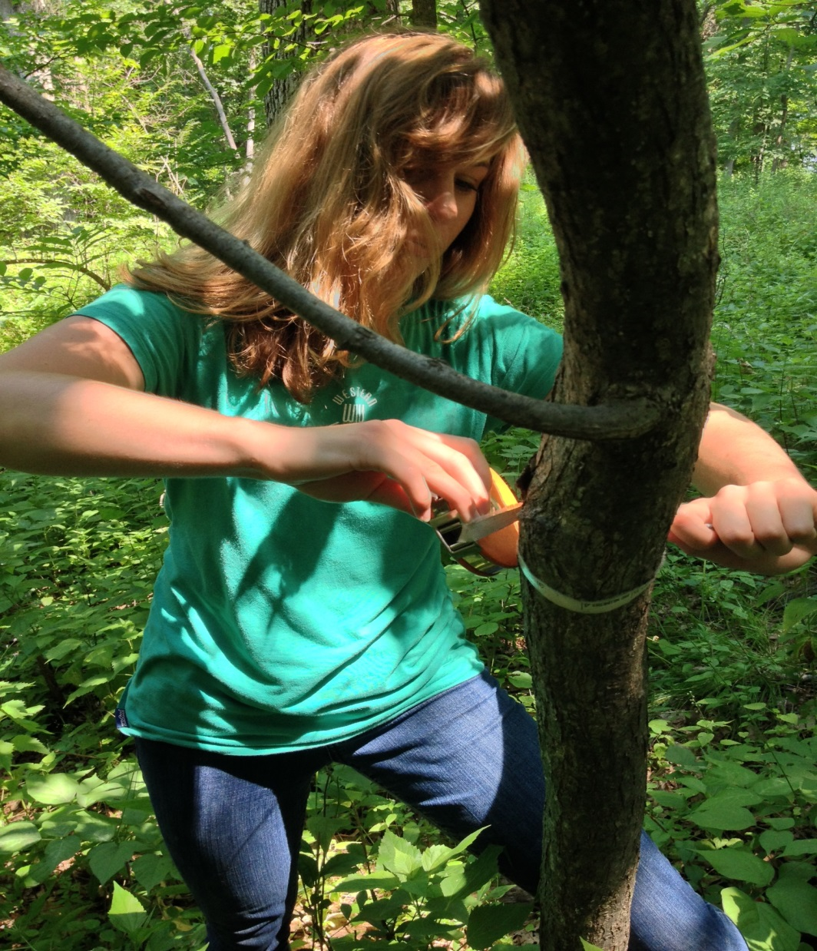
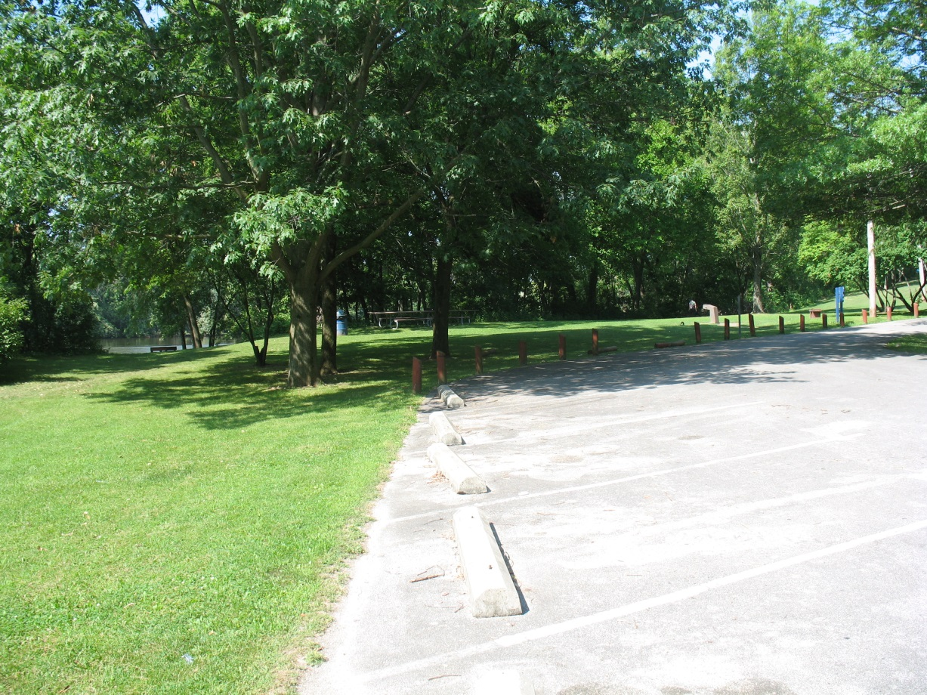
Tree Inventory Analysis: a Comparison of Park Species Richness to the Surrounding Neighborhoods in Rock Island, IL
Kevin Root, Michael Reisner, and Rueben Heine
Department of Environmental Studies, Augustana College
Introduction
Methods
Loss of biodiversity is something we are facing globally, which can change the function of an ecosystem at the local level¹. Changing biodiversity increases likeliness of species invasions and can have direct consequences for human economic and social activities. Since Dutch elm disease’s introduction to the United States, tree diversity has been viewed as an important buffer against tree loss^{2,7}. Biodiversity in the urban setting is influenced by many factors include: park or woodlot size^{1,3}, age of a housing development⁵, the elevation of a location⁶, and socioeconomic status of the neighborhood , which is usually the largest factor^{1,4,5,6}. The emerald ash borer (EAB) and the Asian long-horned beetle arrived in North America just over a decade ago. These two insects are projected to kill more than 1.2 billion trees at a value of around $669 billion⁷. Conserving and enhancing tree biodiversity in urban and suburban settings is critical to ensuring the resilience of urban ecosystems during this invasion. One place that city planners can put their focus is urban parks because they are often important sources of tree diversity and provides critical ecosystem services ^{6,8}. I used the urban parks in Rock Island, IL to assess urban tree diversity.
Research Questions
    Are there differences in the diversity and composition of the urban forests across the parks?
    What is the relationship between such diversity and the socioeconomic status and age of homes in the surrounding neighborhoods?
The study area consisted of 17 parks in Rock Island, IL (Figs. 1-2). In fall of 2013, EAB beetles were found in Hasselroth Park in southwest Rock Island. The park is separated from the main part of the city by the Rock River. In the summer of 2014, an inventory of all trees in manicured areas of all 17 parks was completed. Tree richness and the five most abundant species were calculated for each park. ArcGIS was used to identify all parcels within an 800 meter buffer around each park. Socioeconomic status was estimated using the mean assessed property values of these parcels. The mean age of all houses within the buffer was also calculated. Bivariate correlations (alpha = 0.05) using SPSS was used to assess the relationship between tree richness and household age and mean assessed value.
Results
Figure 4. Five most abundant tree species within each park. Those with less than 5 trees show 100% composition
Tree Diversity: Richness varied from 0.41 (Douglas Park) to 3.04 (Longview Park) and averaged 2.60 across the 17 parks (Fig. 3). Thirty-three different species comprised the 5 most abundant trees in the parks (Fig. 4). The most common species included: Eastern Cottonwood, Crabapple, White Pine, Red Maple, and Green Ash respectively. These five species comprised 38% of all trees across the parks. Only four parks; Douglas, Old Horace Mann, Shadybrook, and Sylvan Parks, had their 5 most abundant trees make up 100% of their canopy. In contrast, Dankman and Longview Parks had their 5 most abundant species make up less than 50% of their canopy.
Diversity vs. Neighborhoods Although there is a weak, negative relationship between park tree richness and house age (R² = 0.07), the relationship was not significant (p = 0.31). There was also a weak, but nonsignficant positive relationship between park tree richness and residential property values (R² = 0.05).
Discussion
Although overall richness was low, 13 of the 17 parks had relatively diverse tree communities
Management should focus on enhancing tree diversity of the four parks with canopies dominated by 5 or less species of trees. Otherwise, these parks will remain especially vulnerable to invasion and disturbances
Although not significant, the positive relationship between neighborhood socioeconomic status and diversity and negative relationship between neighborhood age and diversity are consistent with findings of previous studies ^{1,5,6,7}.
Gaps in the available geospatial data for both assessed value and house age of housing significantly limited our analysis
A complete inventory of all city-owned trees and representative sample of privately-owned trees should be done in order to more accurately assess urban forest diversity and better understand its resilience to EAB invasion and other disturbances.
Planting of replacement trees should focus on increasing diversity with the goal of no one genus of trees comprising >10% of the urban canopy
Figure 3. Species richness of each park in Rock Island, IL.
Acknowledgements
Dr. Michael Reisner and Tara Cullison and the Augustana Upper Mississippi Center for giving me the opportunity to conduct my research.
The Rock Island Public Works Department for allowing me to collect GIS data for them this past summer.
Dr. Reuben Heine of the Augustana Geography Department for helping me with my ArcGIS analysis.
Figure 1. (a) Student taking measurements & (b) city park
Figure 2. Park locations in Rock Island, IL.
Contact
References
Kevin Root
Augustana College
Email: kevinroot11@augustana.edu
Website: augustana.edu
Phone: 630-777-8899
Alvey AA. 2006. Promoting and preserving biodiversity in the urban forest. Urban For Urban Gree [online]. [cited 2014 Nov 30]; 5(4):195-201. Available from: ScienceDirect.
Bassuk NL. 1990. Street tree diversity making better choices for the urban landscape. In: Metria Proceedings. 71-8. Available from: North Carolina State University.
Cornelis J, Hermy M. 2003. Biodiversity relationships in urban and suburban parks in Flanders. Landscape Urban Plan [online]. [cited 2014 Dec 3]; 69(4):385-401. Available from: ScienceDirect.
Dwyer JF, McPherson EG, Schroeder HW, Rowntree RA. 1992. Assessing the benefits and costs of the urban forest. J Arboric [online]. [cited 2014 Dec 5]; 18(5):227-34. Available from: University of Washington.
Hope D, Gries C, Zhu W, Fagan WF, Redman CL, Grimm NB, Nelson AL, Kinzig A. 2003. Socioeconomics drive urban plant diversity. P Natl Acad Sci USA [online]. [cited 2014 Dec 3]; 100(15):8788-92. Available from: Proceedings of the National Academy of Sciences of the United States of America.
Kinzig AP, Warren P, Martin C, Hope D, Katti M. 2005. The effects of human socioeconomic status and cultural characteristics on urban patterns of biodiversity. Ecol Soc [online]. [cited 2014 Dec 3]; 10(1):23-35. Available from: Fresno State University.
Raupp MJ, Cumming AB, Raupp EC. 2006. Street Tree Diversity in Eastern North America and Its Potential for Tree Loss to Exotic Borers. Arboriculture & urban forestry [online]. [cited 2014 Dec 6]; 32(6):297-304. Available from: United States Department of Agriculture National Agriculture Library.
Wolf KL. 2004. Public value of nature: Economics of urban trees, parks and open space. In: Design with Spirit: Proceedings of the 35th Annual Conference of the Environmental Design Research Association. 88-92. Available from edra.org.

