Slide 1
Efficacy of Fifa 11+ Program in Young Female Soccer Players
Clinical Research Training Center
Career Development Awards • Postdoctoral Programs • Predoctoral Programs
John Hallmark

Slide 2
Disclosures
No disclosures

Slide 3
Research Question
Primary- Efficacy of the Fifa 11+ program
Secondary- Relationship between knee movement and Anterior Cruciate Ligament injury

Slide 4
The Anterior Cruciate Ligament (ACL)
Anatomy
Biomechanics
Resistance of forward motion

Slide 5
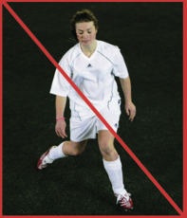
ACL Injury
200,000 tears/year
Non-contact injury in soccer players
Rick Factors
Higher in females
Motion of knee
Difference of strength

Slide 6
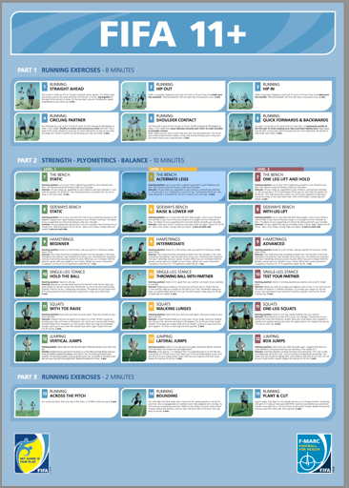
Prevention
Fifa 11+
3 levels of progression
Research
Growing body of Evidence

Slide 7
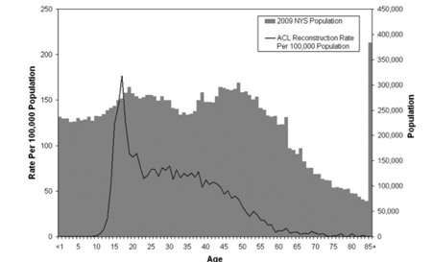
What makes this study different
The factor of age
Fifa 11+ on females
Motion analysis
Noraxon
Dowell et al. AJSM. 2014

Slide 8
Methods
Prospective Cohort
300 females 14-16 years old
Inclusion Criteria
Exclusion Criteria
Time frame
Pretest
10 week
6 month

Slide 9
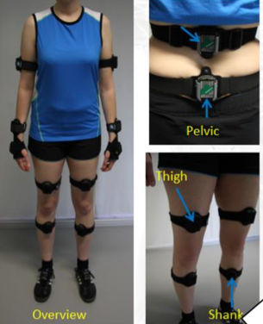
Measurements
Noraxon
Degree of valgus deformity
Numerous readings
Return to play tests
Y-test
Dropdown
Hop test

Slide 10
Initial Results
Problems with Noraxon
Calibration
When can quality control tests start?

Slide 11
References
1. Bizzini M, Junge A, Dvorak J. (2013). Implementation of the FIFA 11+ football warm up program: how to approach and convince the football associations to invest in prevention. Br J Sports Med. 47(12), 803–806.
2. Brophy R, Silvers HJ, Gonzales T, Mandelbaum BR. (2010). Gender influences: the role of leg dominance in ACL injury among soccer players. Br J Sports Med, 44(10), 694–697.
3. Chappell JD, Yu B, Kirkendall DT, Garrett WE. (2002). A comparison of knee kinetics between male and female recreational athletes in stop-jump tasks. Am J Sports Med, 30, 261-7.
4. Dodwell ER, Lamont LE, Green DW, Pan TJ, Marx RG, Lyman S. (2014). 20 years of pediatric anterior cruciate ligament reconstruction in New York State. Am J Sports Med. 42(3), 675-680.
5. Junge A, Lamprecht M, Stamm H, Hasler H, Bizzini M, Tschopp M, Reuter H, Wyss H, Chilvers C, Dvorak J. (2010). Countrywide campaign to prevent soccer injuries in Swiss amateur players. Am J Sports Med, 39(1), 57-63.
6. Silvers-Granelli, H, Mandelbaum, B, Adeniji, O, Insler, S, Bizzini, M, Pohlig, R, …Dvorak, J. (2015). Efficacy of the FIFA 11+ Injury Prevention Program in the Collegiate Male Soccer Player. Am J Sports Med, 43(11), 2628–2637.
7. Soligard, T, Myklebust, G, Steffen, K, Holme, I, Silvers, H, Bizzini, M, … Andersen, T. E. (2008). Comprehensive warm-up programme to prevent injuries in young female footballers: cluster randomised controlled trial. The BMJ, 337, a2469.

Slide 12
Acknowledgement The Clinical Research Training Center is supported by Grants Numbers UL1 TR000448, KL2 TR000450 and TL1 TR000449 from the National Center for Advancing Translational Sciences at the National Institutes of Health
Clinical Research Training Center
Career Development Awards • Postdoctoral Programs • Predoctoral Programs

Slide 13
Thank You

