Slide 1
Critical Engagement
Sean Bennington, Tate Henrikson, Nicolete Moyo, Justin Porter, Mason Sargent

Slide 2
Definition in the Womanist Context
Critical Engagement:
The use of practical strategies and pedagogical methods [that] challenge dominant intellectual legacies, theological resources, and ideologies that undermine the goals of womanist ethics, namely, the empowerment of black women
“From Floyd-Thomas’ Mining the Motherlode: Methods in Womanist Ethics p.13”

Slide 3
Importance of Critical Engagement
“Their ability to critically reflect on their own identity and the forces that seek to annihilate them allows them to subvert normativity?”- Mining the Motherlode, p. 47
What happens if there’s a lack of critical engagement?
Without critical engagement no progress can be made in fighting injustices. Oppressive systems would stay in place and would continue to be the norm. It is crucial for citizens to recognize inequalities within our society and to be critically engaged in order to move towards justice and equality.

Slide 4
Why Critical Engagement Matters: Criminal Justice
Fantastic Hegemonic Imagination
The Criminal Justice System operates fairly and without bias or prejudice
VS
Countermemory
The Criminal Justice System has been operating with systematic prejudices for centuries, and has led to the issue of police brutality in our modern society, specifically against people of color
Emilie Townes

Slide 5
Six Step Approach to Ethical Issues: Melanie Harris
“True womanist spirituality is lived out among the people and within the self as movements of empowerment and action.” (Harris 104)
Uncover Experience and Stories
Validate Experience
Ascertain Values from Critical Reflection of Experience
Connect Values to Wisdom
Taking Action upon the Wisdom and Values
Use Empowerment Gained from the Action to Move toward Justice

Slide 6
Ethical Issue:
Colin Kaepernick

Slide 7
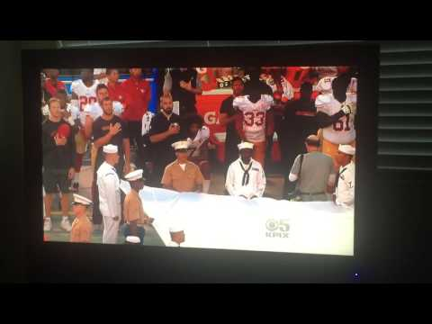
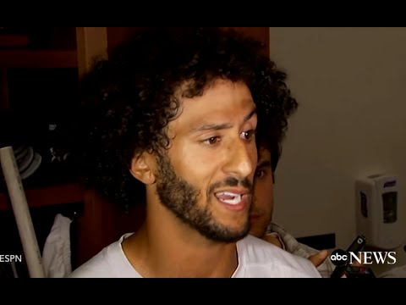
Intro to Ethical Issue: Colin Kaepernick
August 26, 2016, Kaepernick takes knee
August 28, 2016 responds to media

Slide 8
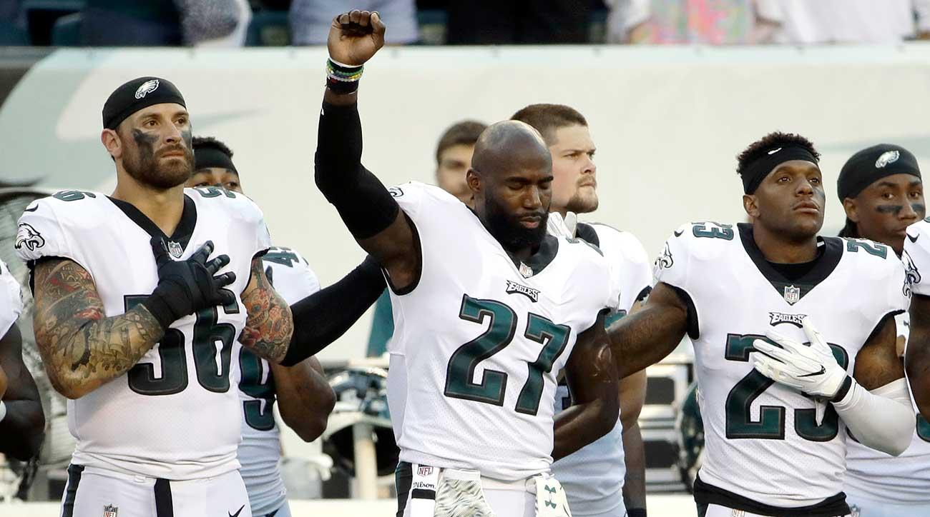
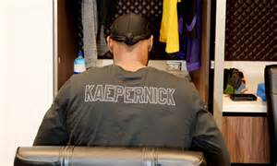
How Kaepernick Exemplifies a Womanist Ethic
Learned/researched statistics that show racial inequality throughout the nation
Saw numerous different cases where young black men had lost their lives at the hands of the police
He embodied key values such as Self-Reliance and Being Resourceful in spite of oppression
Describes being self reliant as the ability to confront an oppressive system and being able to define yourself as human
Took action by kneeling to gain awareness about his fight
Many athletes and other activists supported his cause

Slide 9
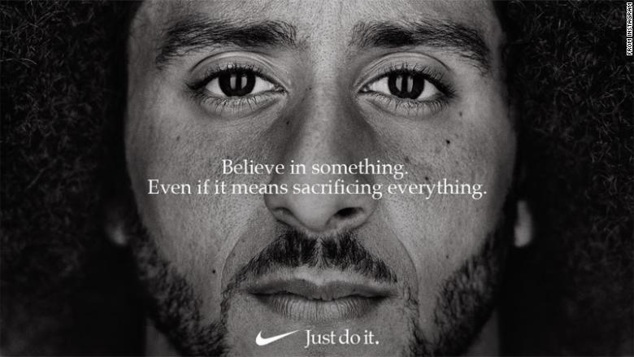

Slide 10
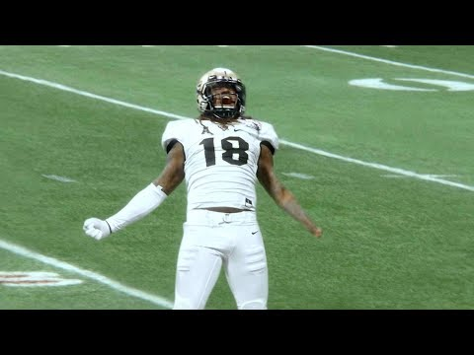
About the Ad
For Nike’s 30 Year Anniversary of the “Just Do It” campaign they used images of former NFL quarterback Colin Kaepernick as the spokesperson
Colin Kaepernick with the help from Nike came up with a phrase to support the movement
“Believe in something. Even if it means sacrificing everything.”
This was not without controversy as many people started boycotting Nike products.
Nike has a history of supporting athletes who have been surrounding with controversy
Along with the still image Ad Nike released a video Ad in which it involved countless stories of individuals and athletes playing their sports even though others might call it crazy

Slide 11
Social Witness: Contemporary Black Women

Slide 12
Tamika Mallory
Leader of Justice League NYC and Women’s March
Speaker at United We Stand rally
“It’s important for us to rally people so all of America is on notice, I don’t think we’re organizing for one man as much as we are what that man stands for.”
“To see Colin Kaepernick take a knee on behalf of our us and our families, on behalf of issues that we have been so vocal about, it really gives us the steam that we need to go forward.”
“For those of us who were involved [in the suspension of Ray Rice], this [organizing on behalf of Kaepernick] is a continuation of that work.”
(Essence article)

Slide 13
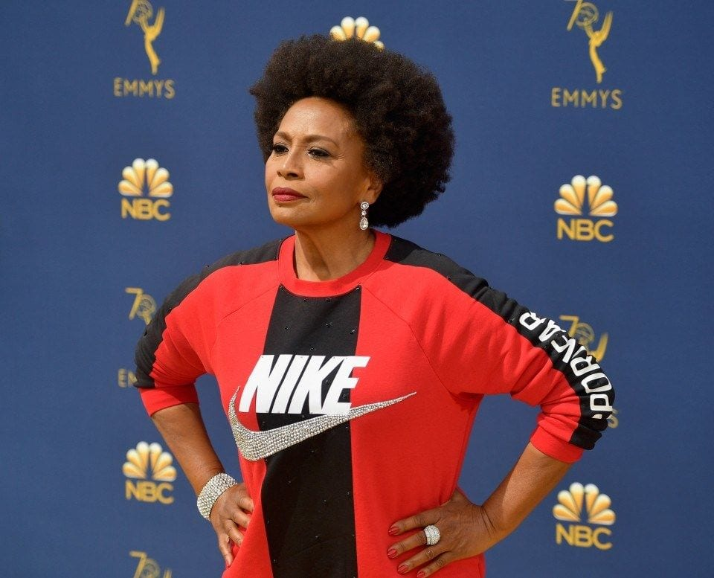
Jennifer Lewis
Bio: Democratic Representative of Virginia’s 6th Congressional District, fights against corruption in the federal government.
“I am wearing Nike to applaud them for supporting Colin Kaepernick and his protest against racial injustice and police brutality,”
“What can I do? What can I do that’s meaningful? I’ll wear Nike,” she said of making that fashion choice. “I’ll wear Nike to say thank you. Thank you for leading the resistance! We need more corporate America to stand up also.”

Slide 14
Creative Application:
Spoken Word Poem

Slide 15
About the Poem
Title: “Just Do It” by: Justin Porter Augie 2021
The poem is to be looked as if you are Colin Kaepernick
It showcases the horrible acts of injustice that Kaepernick has witnessed as he decides to take a knee
While dealing with implications of how the world doesn’t except this movement Kaepernick still did what he thought was best
It wraps up with Nike supporting the cause and making him the cover of 30 year ad

Slide 16
Today is the day my life will change for the better
A simple protest that brings people together
I’m tired of waking up everyday seeing all this death on the news
By doing this I got nothing else to lose
As an athlete I know that I have a platform
No longer do I want to live in a society that thinks this is the norm
So why just not take a knee
This statement I’m about to make is going to be bold
All of my life I’m hearing conflictions of what I should be told
What is going on is not right
So I am going to start this fight
I’m not just doing this for me
I’m doing this so that all of us can feel free
So why not just take a knee
I made this statement so I can fight this oppression
Seeing countless others living with depression
Reflecting on the past so we may not falter
A concept formed by Floyd and preached by Walker
Supported by others so we are making a movement
The moves were made through critical engagement
I’m delivering this message so I can express wholeness and joy
Others believe that I am out here to destroy
My opponents say that I should just focus on the game
But I wanna do this so everyone will remember my name
Movements that were started preaching Black Lives Matter
How come I still feel like I don’t matter
When I do this I don’t mean to offend the troops
I’m just looking back to what happened with my roots
My President that I say isn’t my President says I should be “fired”
A future for all that is to be desired
If you think I’m slowing down I’m just getting started
Until my dream is resolved so that we can remember those who have departed
Red, white, and blue for this country that many call sweet
All I see is red flowing down the street 2 Years into this and I am still going strong
However some people still feel like I am in the wrong
They keep saying that I am wasting my time
I stopped my career and put it all on the line
But to what they say I do not care
I do this for you, your family, your neighbors and people from everywhere
This past month there has been more controversy It’s all just because of a 30 year anniversary Put me on the cover and you know I’m never gonna quit So when you feel scared of what’s not fair Just Do It

Slide 17
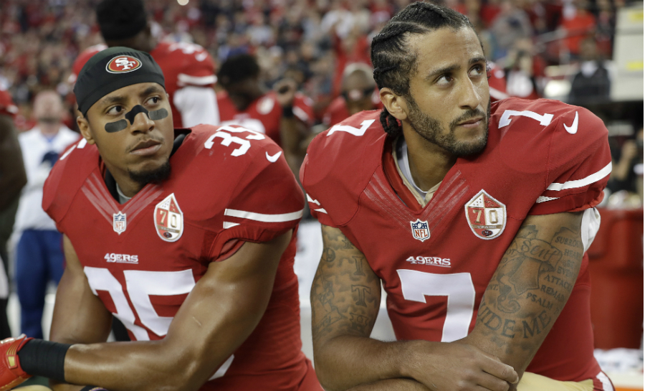
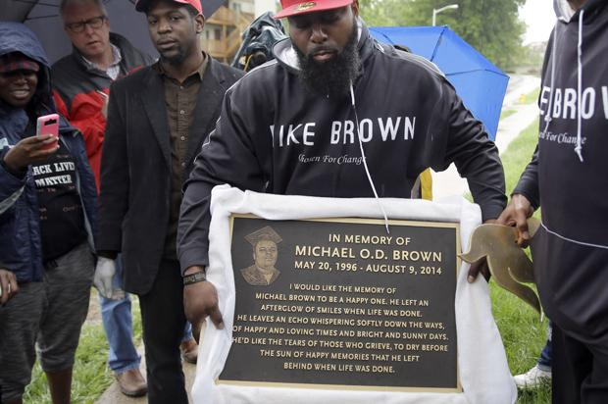
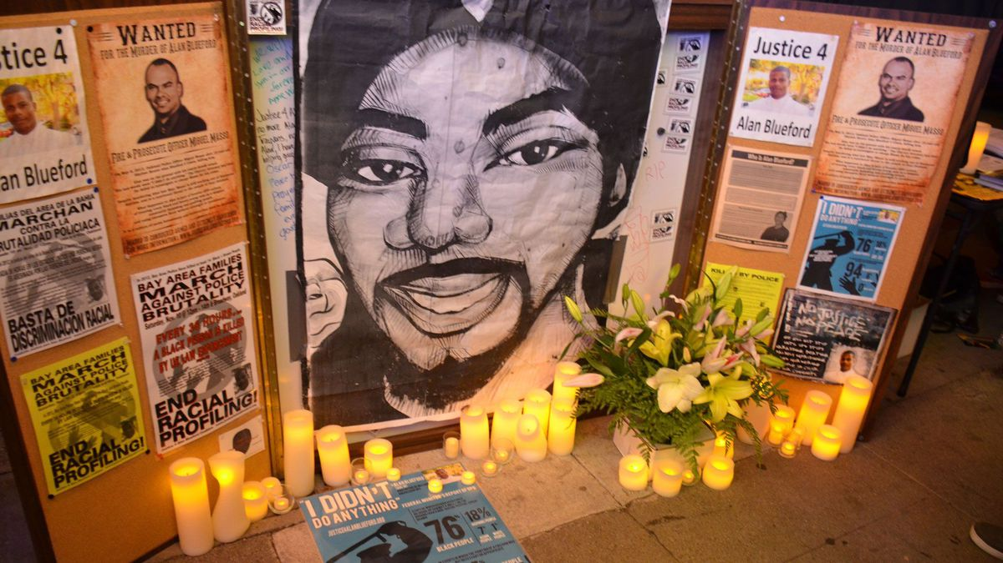
Believe in Something Even if it Means Sacrificing Everything

Slide 18
Works Cited
Bieler, Des. “'Black-Ish' Actress Says 'Thank You' to Colin Kaepernick by Wearing Nike to Emmys.” The Washington Post, WP Company, 17 Sept. 2018, www.washingtonpost.com/news/early-lead
Conteh, Mankaprr. “Black Women Supporting Colin Kaepernick Protest NFL.” Essence, Essence Communications Inc., 23 Aug. 2017, www.essence.com/news/black-women-colin-kaepernick-united-we-stand-rally/.
Floyd-Thomas, Stacey M. Mining the Motherlode: Methods in Womanist Ethics. Pilgrim Press, 2006.
Harris, Melanie L. Gifts of Virtue, Alice Walker, and Womanist Ethics. Palgrave Macmillan, 2013.

